Slide 1

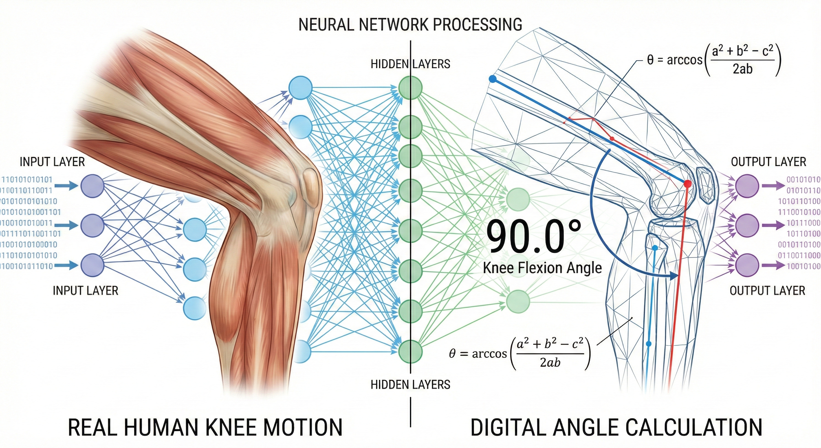
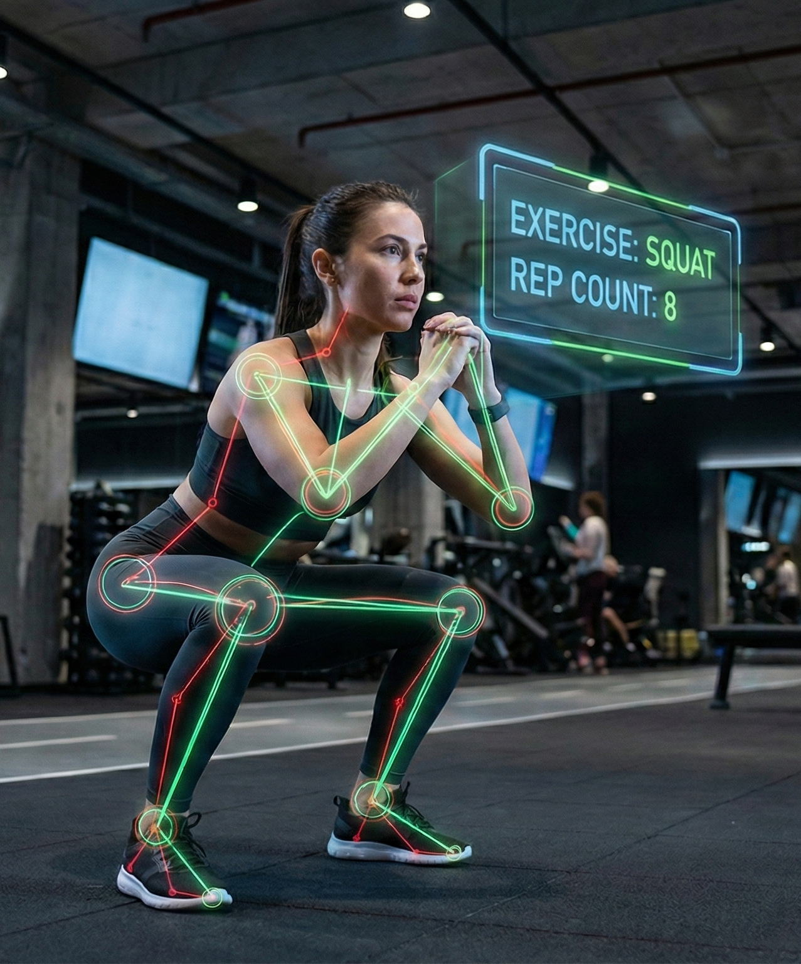
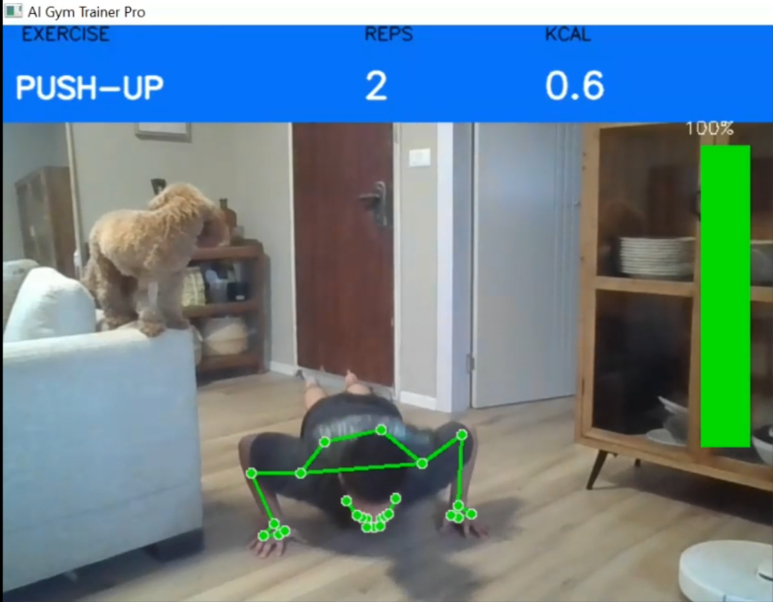
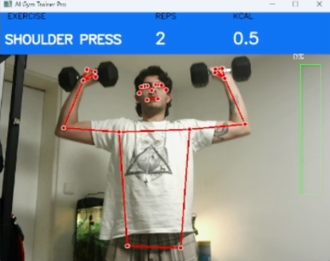
Deep Learning for Computer Science | GymTrainer: Real-Time Exercise Analysis Ori Zarfaty & Amit Wagensberg 2026, A [עברית [
Idan Tobis
Introduction
GymTrainer is a real-time AI fitness assistant that uses Computer Vision and Deep Learning to correct form and count repetitions. It operates on standard webcams, providing immediate audio-visual feedback for Squats, Push-ups, Presses, and Curls without specialized hardware.
Architecture & Methods
Input: Real-time video fed into MediaPipe Pose to extract 33 3D skeletal landmarks.
Feature Engineering: Raw coordinates converted into 6 joint angles.
Classification: A custom LSTM Neural Network processes temporal windows (30 frames) to recognize movement patterns.
Logic: Geometric rules track repetition progress and count reps based on the AI's classification.
Conclusions
High Accuracy: Successfully distinguishes 4 exercise types using temporal data.
Performance: Runs in real-time on standard CPUs.
Robustness: Separating "Recognition" (LSTM) from "Counting" (Geometry) minimizes false positives and ensures accurate tracking.
Discussions
Current Limitations: The system relies heavily on clear visibility of joints. Accuracy drops when users wear baggy clothing or under poor lighting conditions.

